Slide 1
Lecture: 模式识别

Slide 2
目录
模式识别介绍
分类法
简单模式识别例子

Slide 3
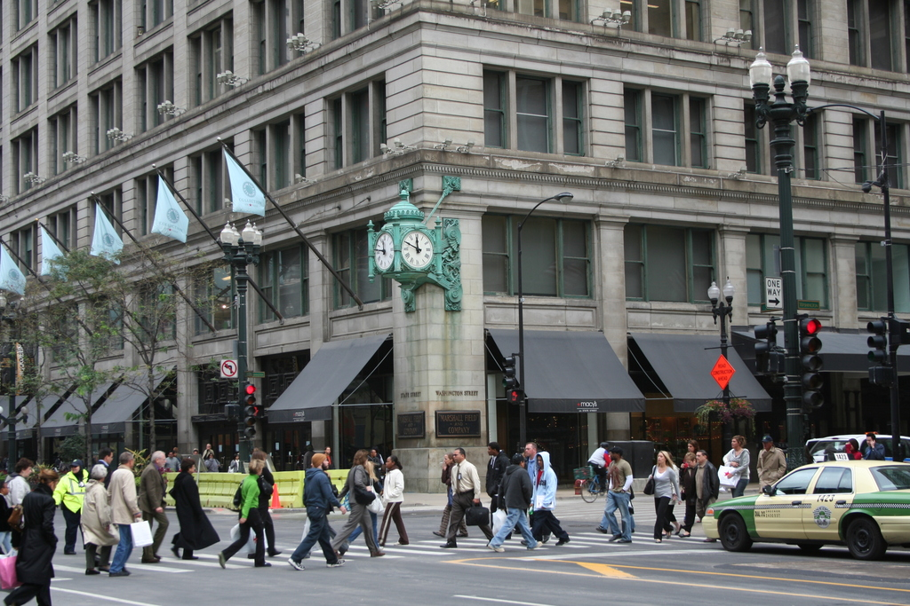
What are the different visual recognition tasks?
Notes:
Let’s give a look at this picture. It’s very easy for use to recognize the content of this picture. This is an urban scene. There is a building, a car, pedestrians and a clock. It would be great if we could design an artificial visual system that mimic human capabilities.
Specifically, what are the tasks we would like such a system to perform?

Slide 4
Classification:
Does this image contain a building? [yes/no]
Yes!

Slide 5
Classification:
Is this an beach?

Slide 6
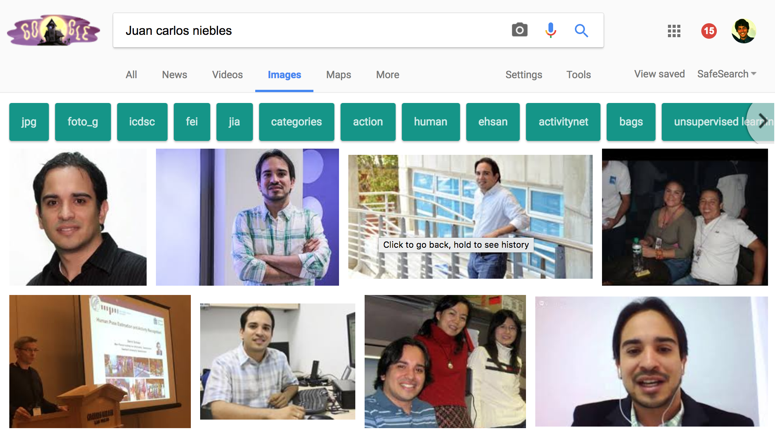
Image search

Slide 7
Image Search
Organizing photo collections

Slide 8
Detection:
Does this image contain a car? [where?]
car

Slide 9
Detection:
Which object does this image contain? [where?]
Building
clock
person
car

Slide 10
Detection:
Accurate localization (segmentation)
clock

Slide 11
Detection: Estimating object semantic & geometric attributes
Object: Building, 45º pose,
8-10 meters away
It has bricks
Object: Person, back;
1-2 meters away
Object: Police car, side view, 4-5 m away
Notes:
If we have an autonomouse vehicle, we would need to recognize that is object is a building, estimate its pose: 45 degree, 5-6 meters away, we would need to tell that this car is the the police car, 2-3 meters away, that is waiting for the traffic light to become green., that there are people on the street; these people are infact crossing the street.

Slide 12
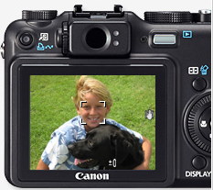
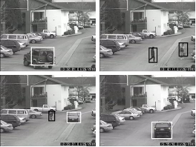
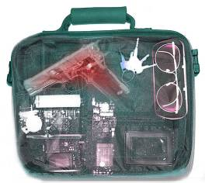
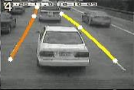
Applications of computer vision
Assistive technologies
Surveillance
Computational photography
Security
Assistive driving

Slide 13
Categorization vs Single instance recognition
Does this image contain the Chicago Macy’s building?

Slide 14
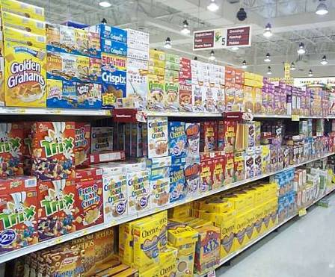
Categorization vs Single instance recognition
Where is the crunchy nut?

Slide 15
Activity or Event recognition
What are these people doing?
Notes:
this device can perform 3D image recording of a face and use it as a password in protected enty points.
The system could be employed at airports or border crossings where a 3-D security camera could scan passengers' faces and compare them with a database of three-dimensional pictures of suspected criminals or terrorists, the twins said.

Slide 16
Visual Recognition
Design algorithms that have the capability to:
Classify images or videos
Detect and localize objects
Estimate semantic and geometrical attributes
Classify human activities and events
Why is this challenging?

Slide 17
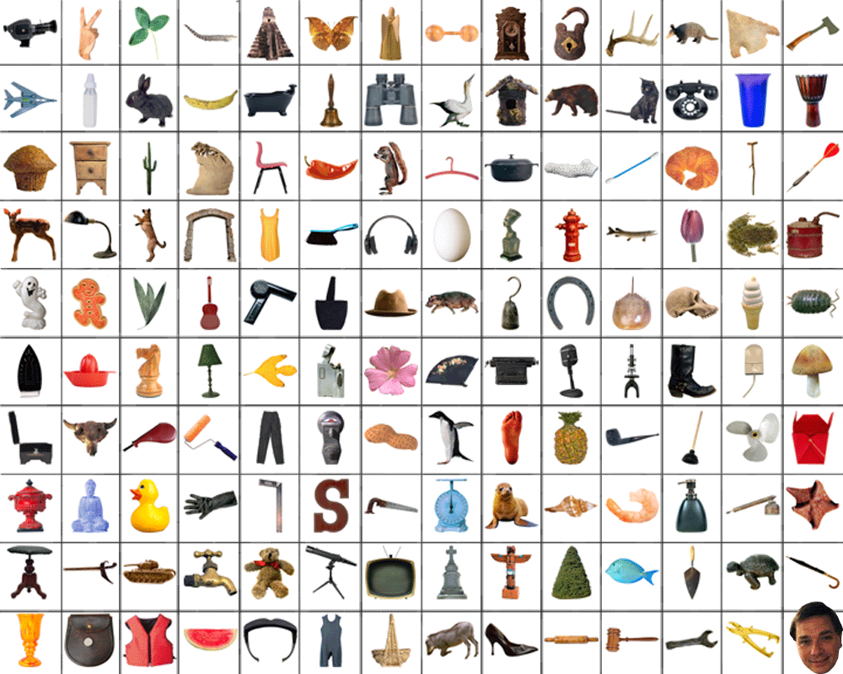
How many object categories are there?
~10,000 to 30,000

Slide 18
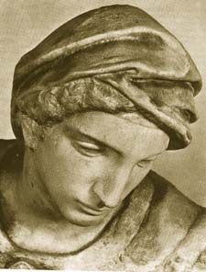
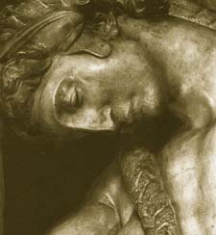
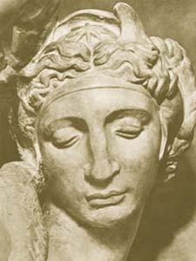
Challenges: viewpoint variation
Michelangelo 1475-1564

Slide 19
Challenges: illumination
image credit: J. Koenderink

Slide 20
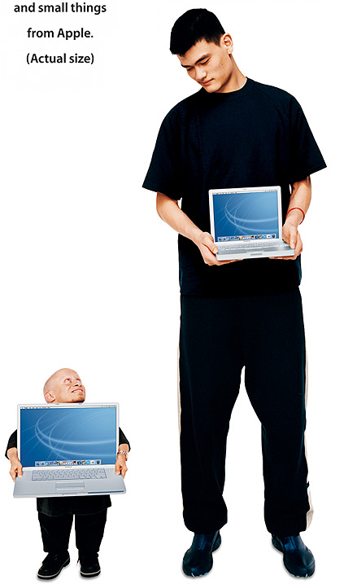
Challenges: scale

Slide 21
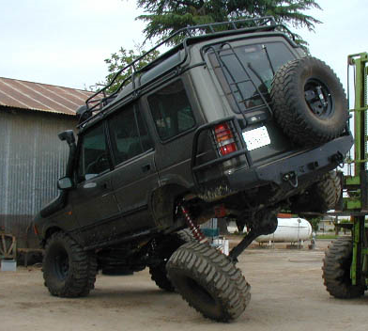
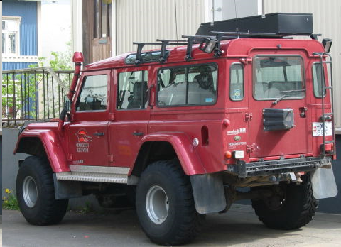
Challenges: deformation

Slide 22
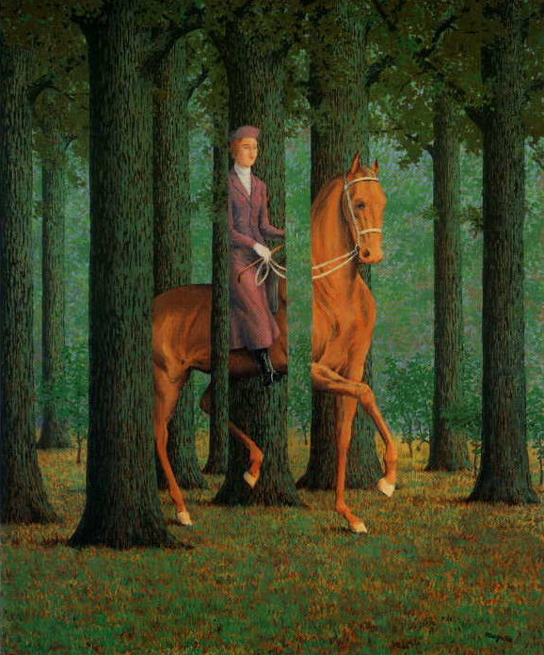
Challenges:
occlusion
Magritte, 1957

Slide 23
Art Segway - Magritte

Slide 24
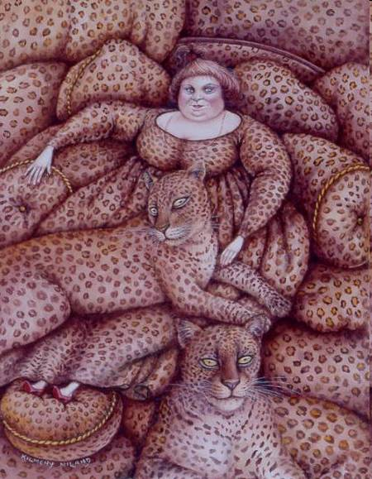
Challenges: background clutter
Kilmeny Niland. 1995

Slide 25
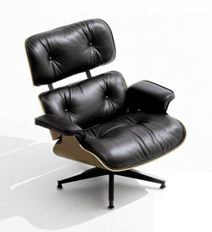
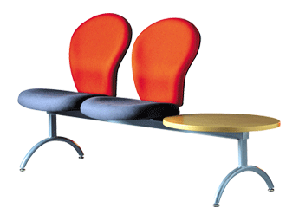
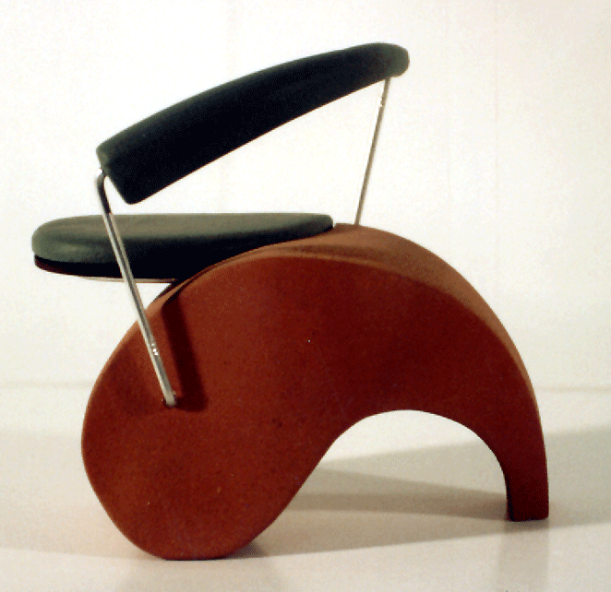
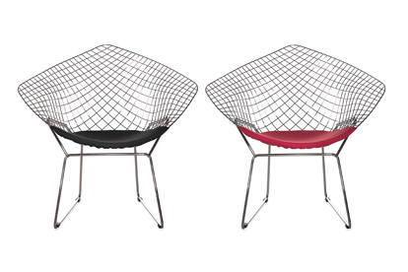
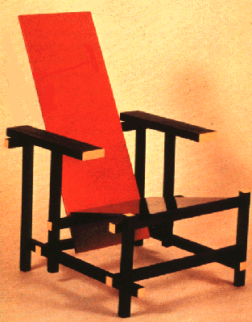
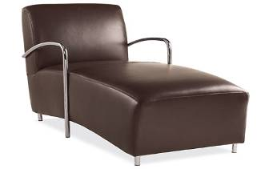
Challenges: intra-class variation

Slide 26


Challenges: big date
[Deng et al. 2009]
www.image-net.org
22K categories and 14M images
Animals
Bird
Fish
Mammal
Invertebrate
Plants
Tree
Flower
Food
Materials
Structures
Artifact
Tools
Appliances
Structures
Person
Scenes
Indoor
Geological Formations
Sport Activities
Notes:
And we do this for the entire wordnet. And this is the core of the imagenet project, Today imagenet has 22K categories and 14M images, all hand labeled by humans. It covers a wide range of categories from animals, plants, to people and activities. It is the largest labeled image dataset that’s freely available to researchers.

Slide 27
ImageNet, 14M
[Deng et al. ’09]
Number of Labeled Images
SUN, 131K
[Xiao et al. ‘10]
LabelMe, 37K
[Russell et al. ’07]
PASCAL VOC, 30K
[Everingham et al. ’06-’12]
Caltech101, 9K
[Fei-Fei, Fergus, Perona, ‘03]
Notes:
And we can compare the scale of images to prior datasets in terms of number of labeled images. This is caltech101, then we have PASCAL VOC, LabelMe, Lotus Hill, and we see that ImageNet is is orders of magnitude bigger.

Slide 28
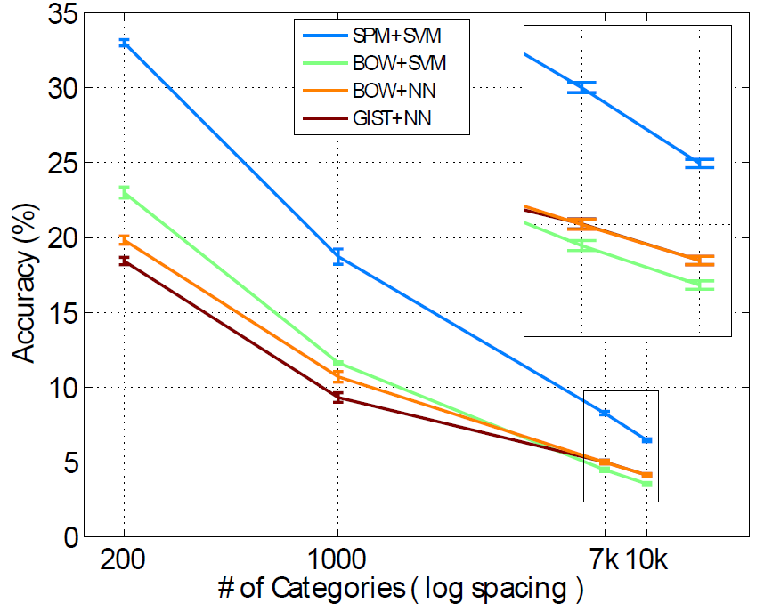
Learn to Classify 10K Classes
9 Million images
4 methods
SPM+SVM [Lazebnik et al. ’06]
BOW+SVM [Csurka et al. ’04]
BOW+NN
GIST+NN [Oliva et al. ’01]
6.4% for 10K categories
Deng, Berg, Li, & Fei-Fei, ECCV2010
Notes:
So they took 9 millions images, which is the entire ImageNet at the time and evaluated 4 state of the art methods, including spatial pyramid plus SVM. It was the first time anybody has tried anything on 10K object classes. Due to time I’ll skip the nitty-gritty details about how we scaled up the methods to work on 10K classes and 9 million images. But I’ll tell you the result. What do you expect the performance to be given that the chance is one out of 10K? It turns out that the accuracy drops to 6.4% for 10K classes. This results was in fact much higher than we expected. On the other hand, it is too low for a practical application. How do we improve the accuracy? Let’s now take a look at what the errors are like.

Slide 29
Challenges
Semantic hierarchy
Fine-grained classes
Large-scale Learning
Notes:
Rich structure. Fine-grained. Textureless.

Slide 30
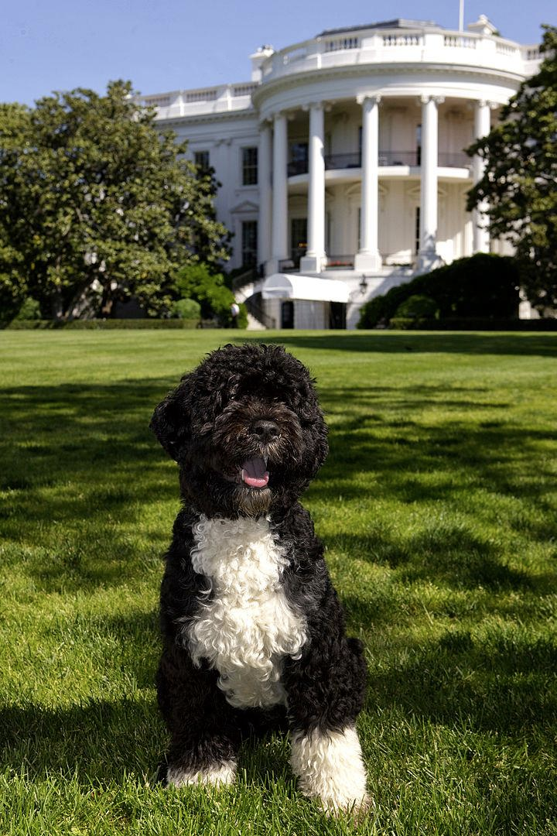
Entity
Animal
Let’s describe at this level
Dog
But it wastes capacity
Portuguese water dog
Bo, the first dog
Notes:
So the problem is that we’d like to find a semantic level to describe things accurately. For example, we can merge all the dogs and only describe at this level. However, it wastes our classification capacity. Because there is a significant amount of time we can confidently predict the breed.

Slide 31
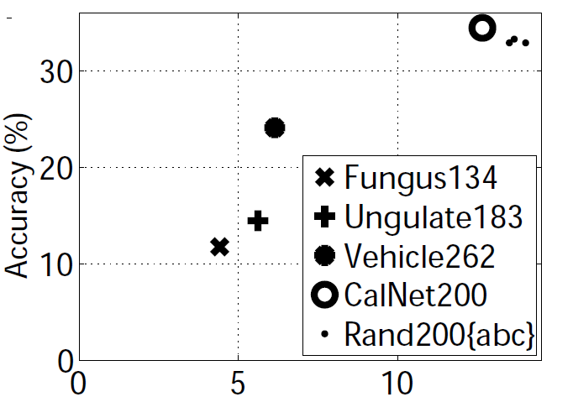
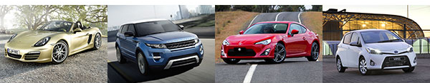
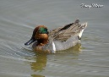

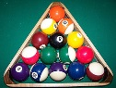
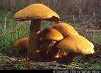
Fine-grained categories are a lot harder
Entity
Entity
Artifact
Artifact
Vehicle
Vehicle
Average Semantic Distance
Finer
Coarser
Deng, Berg, Li, & Fei-Fei, ECCV2010
Notes:
To further confirm this, we did a control experiment that compares the classification accuracy of about 200 classes sampled in different ways. For example, we can sample 200 classes only from the vehicle subtree. [click] Or we can sample it uniformly from all the 10K classes. [click] The 200 vehicles are finer grained while the 200 random classes are coarser grained. [click] This plot shows how the classification accuracy changes with the way we sample our classes. The X axis is the average semantic distances between classes. Here we clearly see that finer-grained classes are much more difficult.

Slide 32
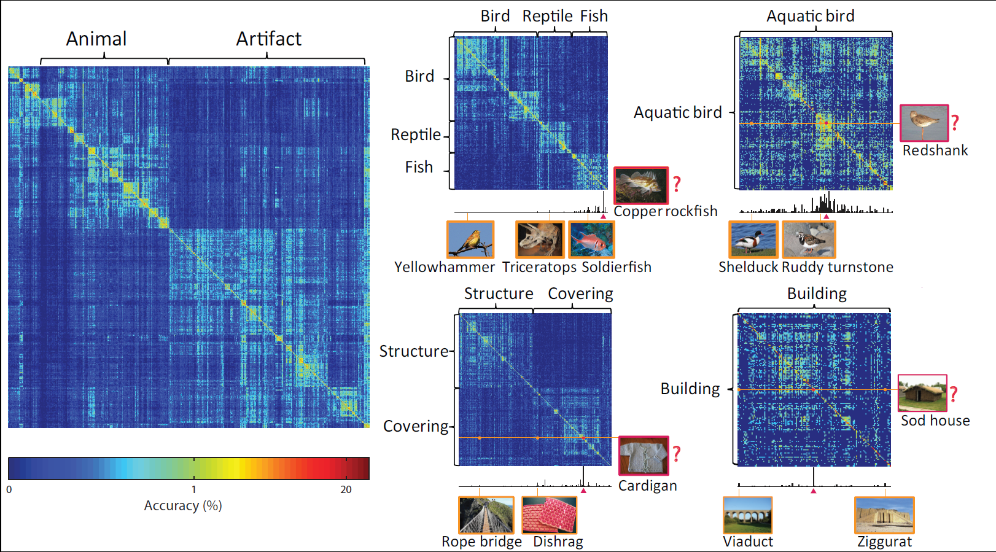
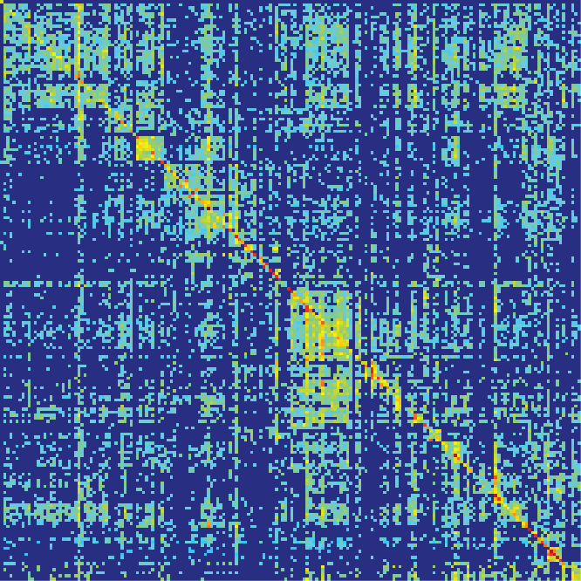
Learn to Classify 10K Classes
Deng, Berg, Li, & Fei-Fei, ECCV2010
Notes:
So we plotted this confusion matrix. Here the columns are order by a DFS of the semantic hierarchy. It means that nearby columns are semantically similar. We can clearly see a block pattern that’s also hierarchical. This indicates that a major source of error is the fine-grained, semantic similar classes, such as different types of dogs, birds, cars.

Slide 33
目录
模式识别介绍
分类法
简单模式识别例子

Slide 34
The machine learning framework
y = f(x)
Training: given a training set of labeled examples {(x₁,y₁), …, (x_{N},y_{N})}, estimate the prediction function f by minimizing the prediction error on the training set
Testing: apply f to a never before seen test example x and output the predicted value y = f(x)
output
prediction function
Image feature
Slide credit: L. Lazebnik

Slide 35
训练
训练图像
特征提取
分类器训练
训练好的分类器
测试
测试图像
特征提取
训练好的分类器
分类结果

Slide 36
有监督学习（supervised learning)：用已知类别的样本训练分类器，以求对训练集数据达到某种最优，并能推广到对新数据的分类。
非监督学习（unsupervised learning) ：样本数据类别未知，需要根据样本间的相似性对样本集进行分类(聚类，clustering)

Slide 37
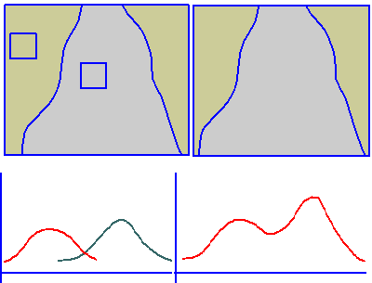
监督与非监督学习方法比较

Slide 38
Classification
Assign input vector to one of two or more classes
Any decision rule divides input space into decision regions separated by decision boundaries
Slide credit: L. Lazebnik

Slide 39
Many classifiers to choose from
K-nearest neighbor
SVM
Neural networks
Naïve Bayes
Bayesian network
Logistic regression
Randomized Forests
Decision Tree
Etc.
Which is the best one?
Slide credit: D. Hoiem

Slide 40
1.近邻法
Assign label of nearest training data point to each test data point
Compute Distance
Test image
Training images
Choose k of the “nearest” records
Source: N. Goyal

Slide 41
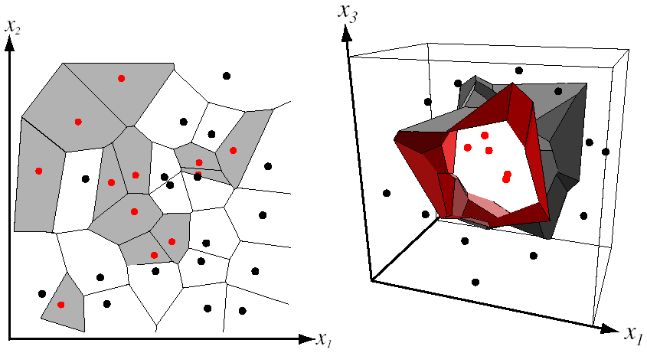
Nearest Neighbor Classifier
Assign label of nearest training data point to each test data point
from Duda et al.
partitioning of feature space
for two-category 2D and 3D data
Source: D. Lowe

Slide 42

K-近邻法
概念
存在一个训练样本数据集合，样本集中每个数据都存在标签，即每一数据与所属分类对应的关系。判定未知类别的数据时，将新数据与样本集中数据进行比较，选择k个最相似数据中出现次数最多的分类，作为新数据的分类。

Slide 43
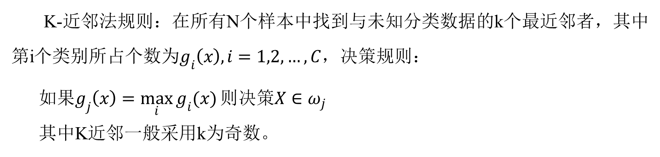
K-近邻法
算法规则
K-近邻法规则：在所有N个样本中找到与未知分类数据的k个最近邻者，其中第i个类别所占个数为$g_{i}\left(x\right),i=1,2,…,C$，决策规则：
如果$g_{j}\left(x\right)=\max_{i}{g_{i}(x)}则决策X∈ω_{j}$
其中K近邻一般采用k为奇数。

Slide 44
K-近邻法
算法基本步骤
1）计算待分类点与已知类别的点之间的距离；
2）按照距离递增次序排序；
3）选取与待分类点距离最小的k个点；
4）确定前k个点所在类别的出现次数；
5）返回前k个点出现次数最高的类别作为待分类点的预测分类。

Slide 45
K-近邻法
参数K的选择
K如果太小，对噪声敏感，如果太大，类别界限变模糊，领域区域可能包含来自其他类的点。
例：图4中数据集都有对应标签。一类是红色的正方形，一类是绿色的三角形，蓝色的圆形是待分类的数据。
K= 3 时，范围内绿色三角形多，待分类点属于绿色三角形类。
K= 7 时，范围内红色正方形多，待分类点属于红色正方形类。
？
解决方案：交叉验证
图4：样本分布图

Slide 46
K-近邻法
利用欧式距离度量可能会得到反直观结果：
例子：
1 1 1 1 1 1 1 1 1 1 0
1 0 0 0 0 0 0 0 0 0 0
vs
0 1 1 1 1 1 1 1 1 1 1
0 0 0 0 0 0 0 0 0 0 1
d = 1.4142
d = 1.4142
解决方案：将向量归一化为单位长度

Slide 47
K-近邻法
特点
简单，易于尝试；
决策边界灵活；
计算机存储容量和计算量大；
错误率的上下界都是在一倍到两倍贝叶斯决策方法的错误率范围内。

Slide 48
2.决策树
训练数据集
This follows an example from Quinlan’s ID3

Slide 49
输出: “buys_computer”决策树
age?
<=30
overcast
>40
30..40
student?
yes
credit rating?
no
yes
excellent
fair
no
yes
no
yes

Slide 50
决策归纳算法
基本算法 (贪婪算法)
树以代表训练样本的单个节点开始
如果样本属于同类，则该节点成为树叶，并用该类标记
否则，使用信息增益的基于熵的度量作为启发信息，选择能够最后地将样本分类的属性
对测试属性的每个已知的值，创建一个分支，据此划分样本
算法使用同样过程，递归形成每个划分上的样本判定树。一旦一属性出现于一节点上，不考虑该节点的任何后代
递归划分停止条件
给定节点的所有样本属于同一类
没有剩余属性可以用来进一步划分样本－使用多数表决
没有样本

Slide 51
属性选择度量: 信息增益 (ID3/C4.5)
选择具有最高信息增益的属性
S是s格数据样本集合,s_{i} 是类C_{i}中的样本数，i = {1, …, m}
给定的样本分类所需的期望信息
A划分成子集的熵(entropy)
A上分支将获得的编码信息是
Notes:
Then how can we decide a test attribute on each node?
One of the popular methods is using information gain measure, which we covered in chapter 5.
It involves rather complicated equations, and I’ll not present the details here. Just basic ideas.
The basic idea is that we select the attribute with the highest information gain.
This information gain can be calculated from the expected information I and entropy of each attribute, E
I : the expected information needed to classify a given sample
E (entropy) : expected information based on the partitioning into subsets by A

Slide 52
计算信息增益选择属性
Class P: buys_computer = “yes”
Class N: buys_computer = “no”
I(p, n) = I(9, 5) =0.940
Compute the entropy for age:

Slide 53
由判定树提取分类规则
以 IF-THEN形式的分类规则表示知识
从根到树叶的每条路径创建一个规则
沿着路径上的每个属性－值对形成规则前件的一个合趣项
叶节点包含类预测
规则易于理解
例子
IF age = “<=30” AND student = “no” THEN buys_computer = “no”
IF age = “<=30” AND student = “yes” THEN buys_computer = “yes”
IF age = “31…40” THEN buys_computer = “yes”
IF age = “>40” AND credit_rating = “excellent” THEN buys_computer = “yes”
IF age = “<=30” AND credit_rating = “fair” THEN buys_computer = “no”

Slide 54
3.最大似然分类
Bayes理论
统计决策理论——根据每一类总体的概率分布决定决策边界
Bayes决策理论是统计决策理论的基本方法
每一类出现的先验概率
类条件概率密度

Slide 55
例：医生要根据病人血液中白细胞的浓度来判断病人是否患血液病。
两类的识别问题。
根据医学知识和以往的经验医生知道：

Slide 56
患病的人，白细胞的浓度服从均值2000，方差1000的正态分布；未患病的人，白细胞的浓度服从均值7000，方差3000的正态分布；
一般人群中，患病的人数比例为0.5%。
一个人的白细胞浓度是3100，医生应该做出怎样的判断？

Slide 57
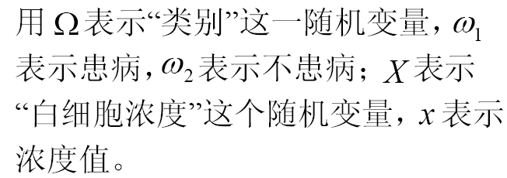

Slide 59
最大似然估计
把模式X分类到
为最大的类别中的分类方法

Slide 60
Naïve Bayes Classifier
朴素假设: 类条件独立:
给定当前类C，数据x₁和x₂ 发生，每个数据独立发生的概率P([y₁,y₂],C) = P(y₁,C) * P(y₂,C)
属性间没有依赖关系
很大减少计算花费,仅计算类区分
移动概率P(X|C_{i})已知,以概率P(X|C_{i})*P(C_{i})分配X给类

Slide 61
训练数据集
Class:
C1:buys_computer=
‘yes’
C2:buys_computer=
‘no’
Data sample
X =(age<=30,
Income=medium,
Student=yes
Credit_rating=
Fair)

Slide 62
Naïve 贝叶斯分类:例子
为每个类计算P(X/Ci)
P(age=“<30” | buys_computer=“yes”) = 2/9=0.222
P(age=“<30” | buys_computer=“no”) = 3/5 =0.6
P(income=“medium” | buys_computer=“yes”)= 4/9 =0.444
P(income=“medium” | buys_computer=“no”) = 2/5 = 0.4
P(student=“yes” | buys_computer=“yes)= 6/9 =0.667
P(student=“yes” | buys_computer=“no”)= 1/5=0.2
P(credit_rating=“fair” | buys_computer=“yes”)=6/9=0.667
P(credit_rating=“fair” | buys_computer=“no”)=2/5=0.4
X=(age<=30 ,income =medium, student=yes,credit_rating=fair)
P(X|Ci) : P(X|buys_computer=“yes”)= 0.222 x 0.444 x 0.667 x 0.0.667 =0.044
P(X|buys_computer=“no”)= 0.6 x 0.4 x 0.2 x 0.4 =0.019
P(X|Ci)*P(Ci ) : P(X|buys_computer=“yes”) * P(buys_computer=“yes”)=0.028
P(X|buys_computer=“yes”) * P(buys_computer=“yes”)=0.007
X belongs to class “buys_computer=yes”

Slide 63
Naïve 贝叶斯分类:注解
优点 :
易于实现
在很多情况下得到好结果
缺点
假设: 类条件独立,因此损失精确性
实际上,变量间存在依靠
E.g., 医院:病人:轮廓:年龄,家庭历史 etc
征兆: 发烧,咳嗽 etc., 疾病:肺癌, 糖尿病 etc
这些依靠不能被Naïve 贝叶斯分类建模
如何处理这些依赖?
贝叶斯信念网络

Slide 64

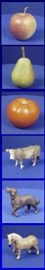
4.方法总结
Training set (labels known)
Test set (labels unknown)
How well does a learned model generalize from the data it was trained on to a new test set?
Slide credit: L. Lazebnik

Slide 65
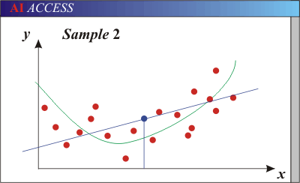
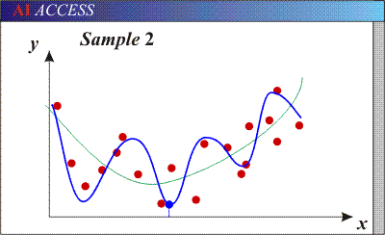
Bias-Variance Trade-off
Models with too few parameters are inaccurate because of a large bias (not enough flexibility).
Models with too many parameters are inaccurate because of a large variance (too much sensitivity to the sample).
Slide credit: D. Hoiem
Notes:
http://www.aiaccess.net/English/Glossaries/GlosMod/e_gm_bias_variance.htm

Slide 66
Bias versus variance
Components of generalization error
Bias: how much the average model over all training sets differ from the true model?
Error due to inaccurate assumptions/simplifications made by the model
Variance: how much models estimated from different training sets differ from each other
Underfitting: model is too “simple” to represent all the relevant class characteristics
High bias and low variance
High training error and high test error
Overfitting: model is too “complex” and fits irrelevant characteristics (noise) in the data
Low bias and high variance
Low training error and high test error
Slide credit: L. Lazebnik

Slide 67
Bias versus variance trade off

Slide 68
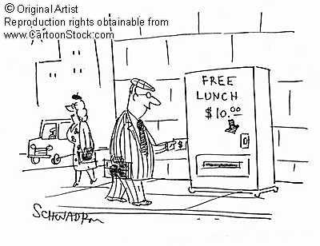
Remember…
No classifier is inherently better than any other: you need to make assumptions to generalize
Three kinds of error
Inherent: unavoidable
Bias: due to over-simplifications
Variance: due to inability to perfectly estimate parameters from limited data
Slide credit: D. Hoiem
Notes:
You can only get generalization through assumptions.

Slide 69
How to reduce variance?
Choose a simpler classifier
Regularize the parameters
Get more training data
How do you reduce bias?
Slide credit: D. Hoiem
Notes:
The simpler classifier or regularization could increase bias and lead to more error.

Slide 70
Last remarks about applying machine learning methods to object recognition
There are machine learning algorithms to choose from
Know your data:
How much supervision do you have?
How many training examples can you afford?
How noisy?
Know your goal (i.e. task):
Affects your choices of representation
Affects your choices of learning algorithms
Affects your choices of evaluation metrics
Understand the math behind each machine learning algorithm under consideration!

Slide 71
目录
模式识别介绍
分类法
简单模式识别例子

Slide 72
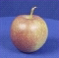
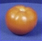
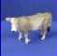
Object recognition: a classification framework
Apply a prediction function to a feature representation of the image to get the desired output:
f( ) = “apple”
f( ) = “tomato”
f( ) = “cow”
Dataset: ETH-80, by B. Leibe
Slide credit: L. Lazebnik

Slide 73
A simple pipeline - Training
Training Images
Image Features

Slide 74
A simple pipeline - Training
Training Labels
Training Images
Image Features
Training

Slide 75
A simple pipeline - Training
Training Labels
Training Images
Image Features
Training
Learned Classifier

Slide 76
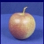
A simple pipeline - Training
Training Labels
Training Images
Image Features
Training
Learned Classifier
Test Image
Image Features

Slide 77
A simple pipeline - Training
Training Labels
Training Images
Image Features
Training
Learned Classifier
Test Image
Image Features
Learned Classifier
Prediction

Slide 78
A simple pipeline - Training
Training Labels
Training Images
Image Features
Training
Learned Classifier
Test Image
Image Features
Learned Classifier
Prediction

Slide 79
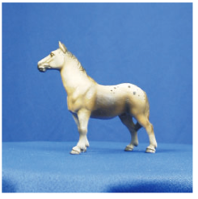
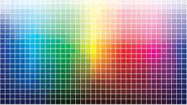
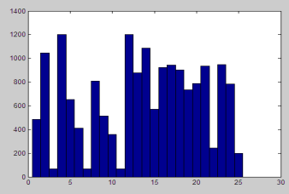
Image features
Input image
Color: Quantize RGB values
Invariance?
? Translation
? Scale
? Rotation
? Occlusion

Slide 80


Image features
Input image
Color: Quantize RGB values
Invariance?
? Translation
? Scale
? Rotation (in-planar)
? Occlusion

Slide 81

Image features
Input image
Color: Quantize RGB values
Invariance?
? Translation
? Scale
? Rotation (in-planar)
? Occlusion
Global shape: PCA space
Invariance?
? Translation
? Scale
? Rotation (in-planar)
? Occlusion

Slide 82
Image features
Input image
Color: Quantize RGB values
Invariance?
? Translation
? Scale
? Rotation (in-planar)
? Occlusion
Global shape: PCA space
Invariance?
? Translation
? Scale
? Rotation (in-planar)
? Occlusion

Slide 83
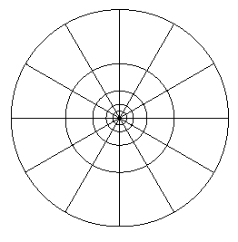
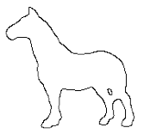
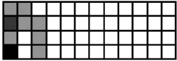
Image features
Input image
Color: Quantize RGB values
Invariance?
? Translation
? Scale
? Rotation
? Occlusion
Global shape: PCA space
Invariance?
? Translation
? Scale
? Rotation
? Occlusion
Local shape: shape context
Invariance?
? Translation
? Scale
? Rotation (in-planar)
? Occlusion

Slide 84
Image features
Input image
Color: Quantize RGB values
Invariance?
? Translation
? Scale
? Rotation
? Occlusion
Global shape: PCA space
Invariance?
? Translation
? Scale
? Rotation
? Occlusion
Local shape: shape context
Invariance?
? Translation
? Scale
? Rotation (in-planar)
? Occlusion

Slide 85
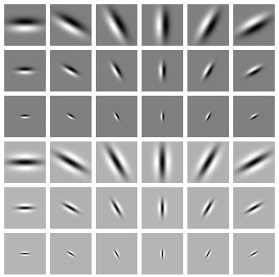
Image features
Input image
Color: Quantize RGB values
Invariance?
? Translation
? Scale
? Rotation
? Occlusion
Global shape: PCA space
Invariance?
? Translation
? Scale
? Rotation
? Occlusion
Local shape: shape context
Invariance?
? Translation
? Scale
? Rotation (in-planar)
? Occlusion
Texture: Filter banks
Invariance?
? Translation
? Scale
? Rotation (in-planar)
? Occlusion

Slide 86
Image features
Input image
Color: Quantize RGB values
Invariance?
? Translation
? Scale
? Rotation
? Occlusion
Global shape: PCA space
Invariance?
? Translation
? Scale
? Rotation
? Occlusion
Local shape: shape context
Invariance?
? Translation
? Scale
? Rotation (in-planar)
? Occlusion
Texture: Filter banks
Invariance?
? Translation
? Scale
? Rotation (in-planar)
? Occlusion

Slide 87
A simple pipeline - Training
Training Labels
Training Images
Image Features
Training
Learned Classifier
Test Image
Image Features
Learned Classifier
Prediction

Slide 88
Classifiers: Nearest neighbor
Training examples from class 2
Training examples from class 1
Slide credit: L. Lazebnik

Slide 89
A simple pipeline - Training
Training Labels
Training Images
Image Features
Training
Learned Classifier
Test Image
Image Features
Learned Classifier
Prediction

Slide 90
Classifiers: Nearest neighbor
Test example
Training examples from class 2
Training examples from class 1
Slide credit: L. Lazebnik

Slide 91


Results
Dataset: ETH-80, by B. Leibe, 2003

Slide 92

Results
Dataset: ETH-80, by B. Leibe, 2003

